Slide 1
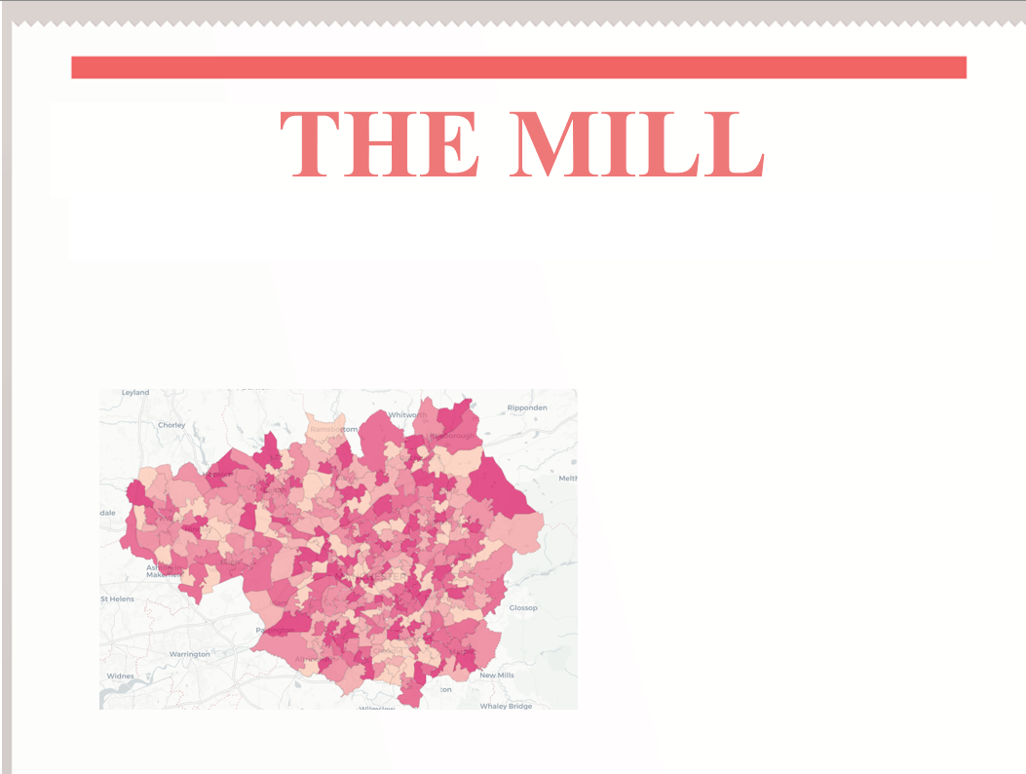

P09- Mapping and Spatial Analysis
Tool for Journalism
P09 The Mill
Mapping and Spatial Analysis Tool for Journalism
Group Members:
11378273
11454639
11484337
11467317
11349153

Slide 2
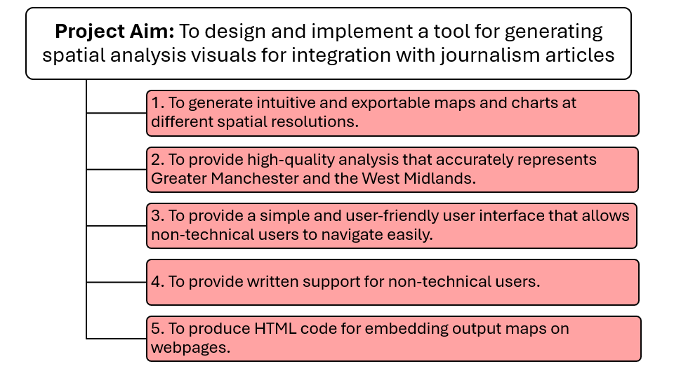
Project Aim & Deliverables

Slide 3
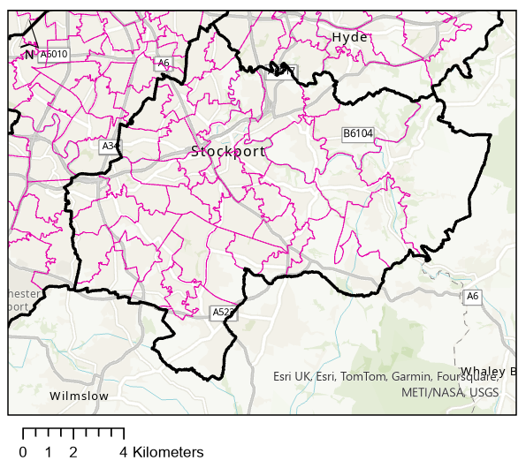
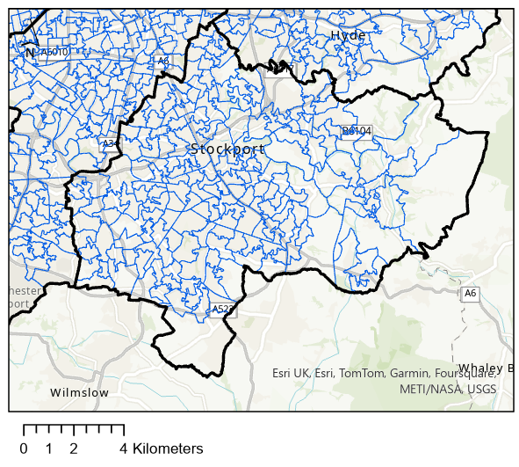

Geographic Boundaries
Figure 1: Stockport maps exemplifying LTLA, MSOA and LSOA geographic boundaries.
Lower Layer Super Output Areas - between 1,000 & 3,000 persons
Middle Layer Super Output Areas - between 5,000 & 15,000 persons
Lower Tier Local Authorities - districts council areas

Slide 4
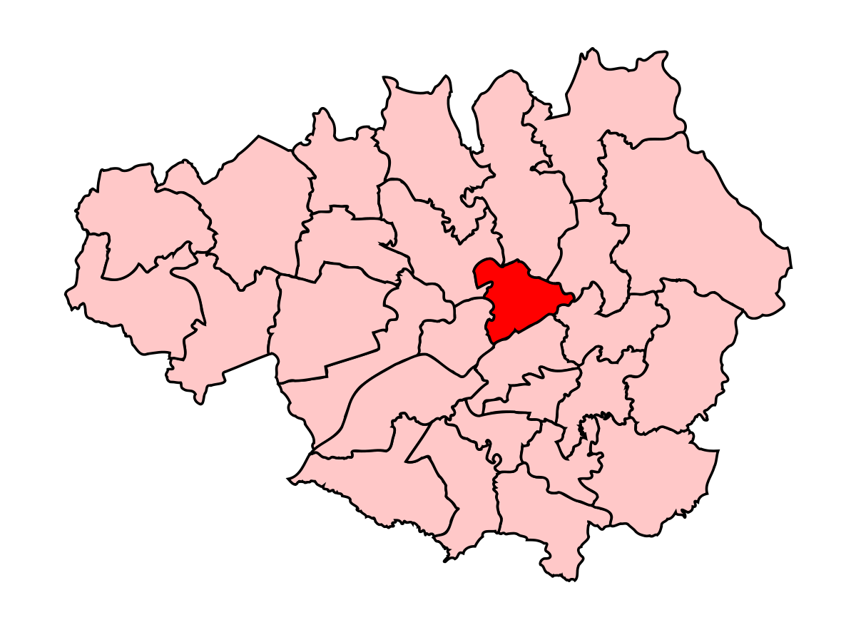

Data Description
Demographic Dataset:
Shapefile Dataset:
Data type; Discrete Integer type values
Measures: count of people in each category except for household
Demographic attributes used: resident population and their distinct characteristics like age, ethnicity,partnership status
Filtered for GM and WM
Region of interest: Greater Manchester and West Midlands
Geographic boundaries ; LSOA,MSOA and LTLA
Files contained;.shp ,.shx ,.dbf , .prj and .cpg
Attributes of shapefiles: Region ID, Shape Length,Area and Coordinates

Slide 5
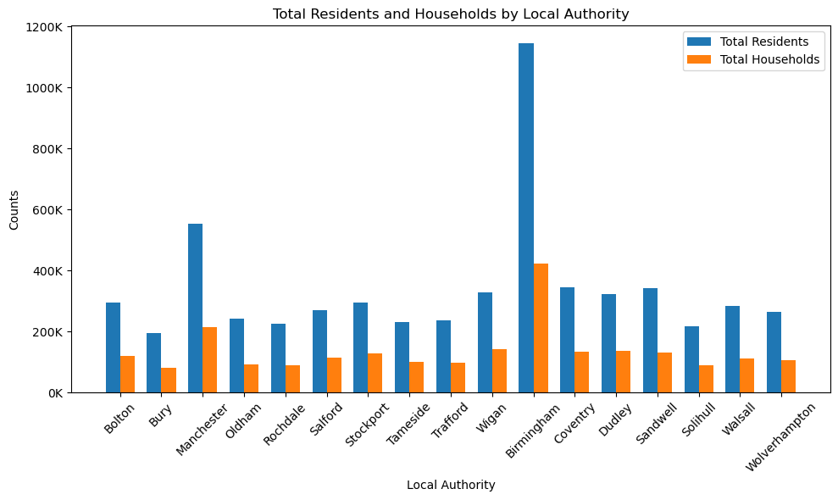
Exploratory Data Analysis
Comparison of number of residents and household per Local Authority
Missing values in some regions were found in the resident type dataset(ts001).
Household refers to people living in the same address while resident refers to each individual in the household.
Figure 2: Bar plots showing total number of residents and households in GM and WM, data sourced from ONS,2021

Slide 6
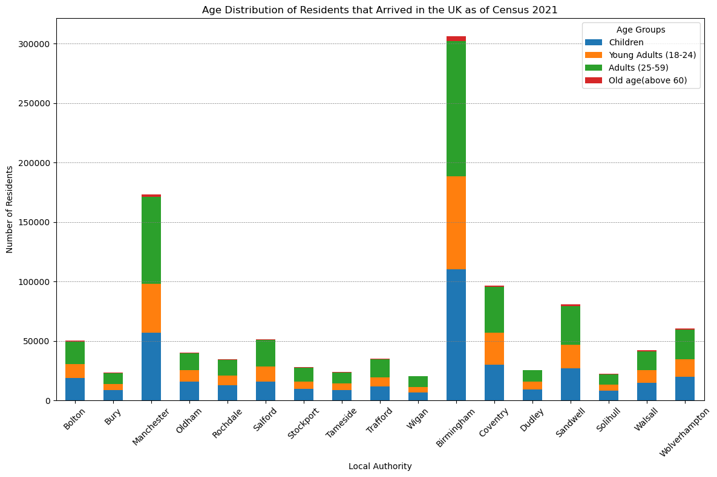
Exploratory Data Analysis
Age Distribution of Residents that Arrived in the UK as of Census 2021 by Local Authority in Greater Manchester and West Midlands
13 age groups classified into 4 categories;
Children 0-17years
Young Adults 18-24 years
Adults 25-59 years
Old age above 60 years
Figure 3: Stacked bar plot showing total number of residents as per age group, data sourced from ONS,2021

Slide 7
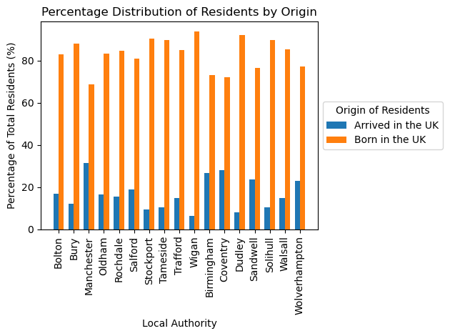
Exploratory Data Analysis
Distribution of Residents by Origin in Various Local Authorities in Greater Manchester and West Midlands(2021 Census Data)
Majority of the population are residents born in the UK.
Total population in GM and WM is 5,787,415 people.
Figure 4: Bar plots showing percentage of total residents by origin(UK), data sourced from ONS,2021

Slide 8
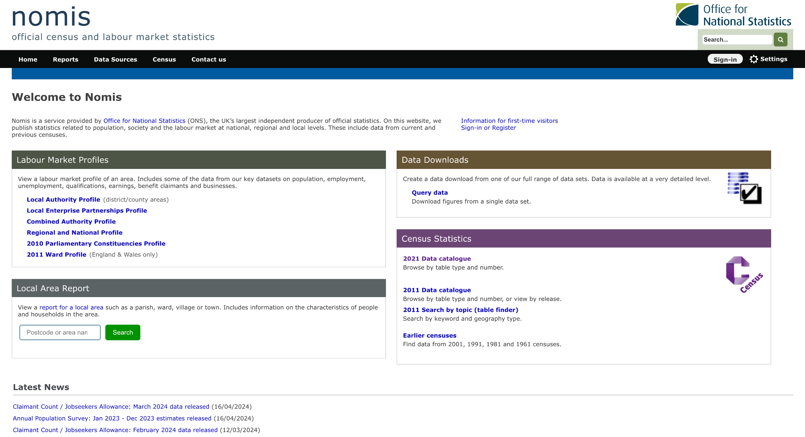
Data Handling & Preprocessing
Primary Data Source
Utilized the ONS Nomis for comprehensive demographic data across multiple geographic levels—LSOA, MSOA, LTLA.
Data Handling Process
Bulk downloading of data into a common folder accessible to all team members, followed by precise data filtering using a custom Python script focusing on Greater Manchester and West Midlands.
Challenges and Solutions
https://www.nomisweb.co.uk/
Addressed data consistency and missing data issues by selecting only those datasets that provided accurate data across all spatial resolutions, and manually fixed some datasets, ensuring integrity and usability for detailed spatial analysis.

Slide 9
Combining Datasets & Storage
 | Demographic data csv Files | Greater Manchester Shapefiles | West Midlands Shapefiles
LSOA | Geography code | ‘code’ | ‘lsoa21cd’
MSOA | Geography code | ‘msoa21cd’ | ‘msoa21cd’
LTLA | Geography code | ‘geo_code’ | ‘ltla22cd’
Table 1: Region codes of csv and shape files at different spatial resolution levels
Importance of Dataset Integration
Resolving Data Integration Challenges
Storage Strategy
Critical for the successful generation of thematic maps, involving the layering of shapefiles with demographic data CSV files.
Detailed exploration of CSV files and shapefiles revealed inconsistencies in variable names for region IDs. For instance:
‘code’ in GM is ‘lsoa21cd’ in WM’s shapefiles
All demographic data CSV files used 'geography code' to denote region ID, enabling a standard point of reference.
All processed data is currently stored locally, ensuring immediate access for the team and secure handling during the initial phases of the project.
Aspiring to transition to cloud storage to enhance data accessibility, improve collaboration efficiency and usability, and ensure scalable management of increasing data volumes.

Slide 10
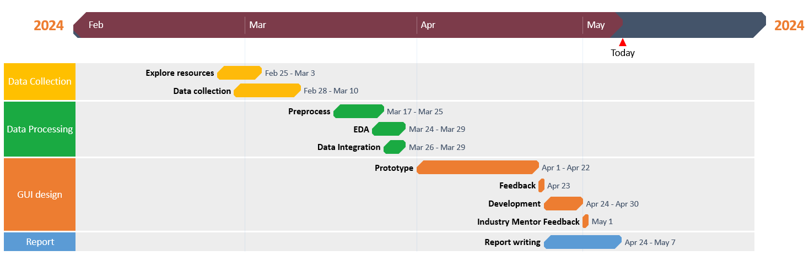
Project Timeline and Management
Figure 5: Project Timeline Gantt chart
Management
Roles & Responsibilities
Agile Framework: Adopted Agile framework for its iterative development and adaptability.
Dynamic Gantt Chart: Employed to manage and visualize project phases with specific start and end dates. Phases included Data Collection, Data Processing, GUI Design, Feedback, and Report Writing.
Agile Sprints and Stakeholder Feedback: Engaged in regular sprints and meetings for continuous feedback, allowing for timely adjustments to project scope and deliverables.
Evelyn and Aisha: Focused on data research and dataset integration, ensuring data consistency and analytical value for the tool.
Abhinandhan and Angel: Concentrated on the GUI design and implementation, aiming to simplify complex spatial analysis into user-friendly operations for journalists.
Abdulaziz: Implemented the data filtering stage to stay within the scope of the project,
Collaborative Effort: Data collection, innovative solutions, and feedback were managed by the team to maximize efficiency.

Slide 11

Project Challenges
Initial Delays and Scheduling Conflicts
Faced challenges like delayed start, other academic commitments, and the industry partner’s lack of initial availability, adjusted timelines using an adaptable Gantt chart.
Technical Challenges
Encountered issues with GeoJson file formats and discrepancies in coordinate systems, necessitating building tools from scratch and systems conversion.
Overcoming Web Development Demands
Only one team member had a computer science background; the team adapted by leveraging existing skills and strategic planning, successfully navigating extensive industry demands.

Slide 12

User Interface (UI)
OVERVIEW
Front-end technologies used: HTML, CSS, JavaScript & Bootstrap library to ensure clean and compact layout
Responsive design for cross-device accessibility (desktops to mobile phones)
Dark and minimalistic theme enhances aesthetic appeal and reduces eye strain during prolonged use, especially in low-light environments
Aligns with user-centric design principles
Focuses on creating a visually appealing interface which is easy to navigate

Slide 13
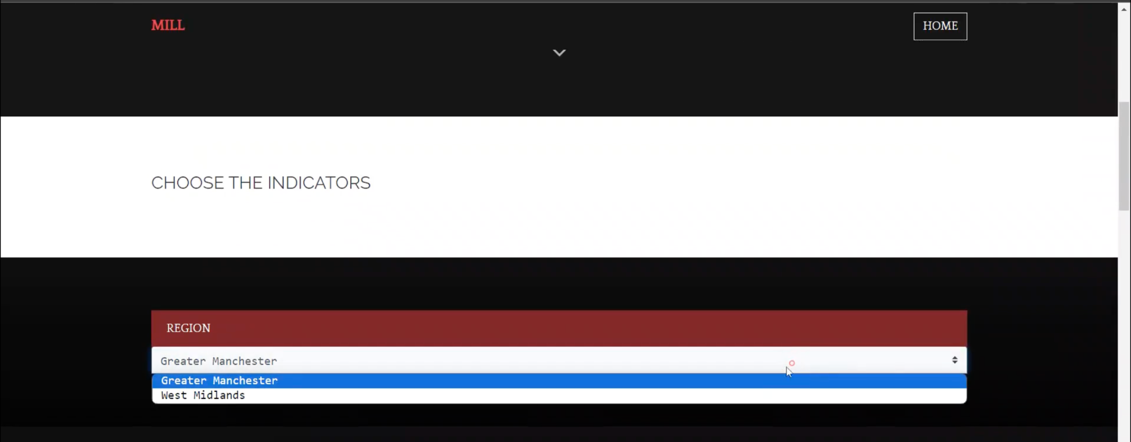
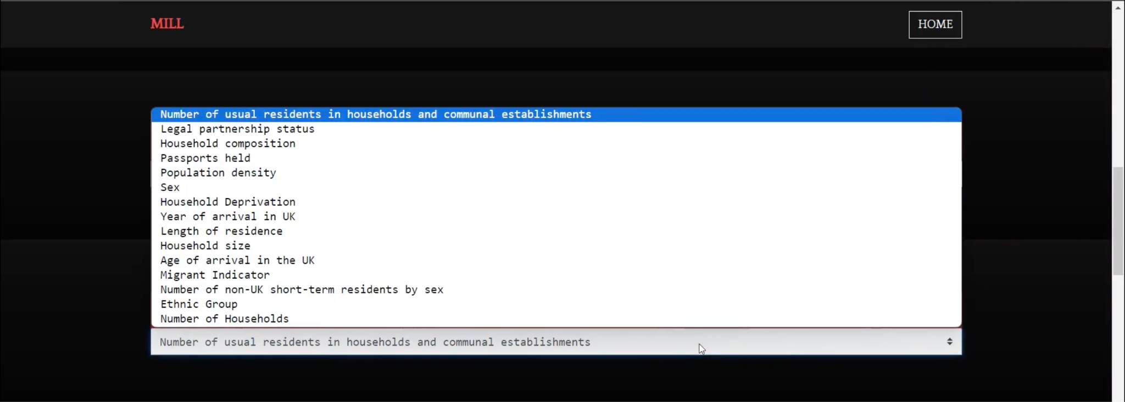
User Interface (UI)
DATA EXPLORATION
Hierarchical Structure for Navigating and Selecting Data
The UI provides a hierarchical structure through the "DEMOGRAPHIC CATEGORY," "REGION," and "DATA LEVEL" sections
This allows users to navigate and customize the analysis to their specific needs and interests
Empowering Users to Tailor the Analysis
The diverse set of options enables users to investigate various aspects of the spatial data, such as population characteristics, migration patterns, or socioeconomic indicators, etc.
Users can explore the data at different geographic scales (e.g., LSOA, MSOA, lTLA)
Providing Additional Context
Features like map legends give users more context and details about the displayed geospatial data points or regions

Slide 14
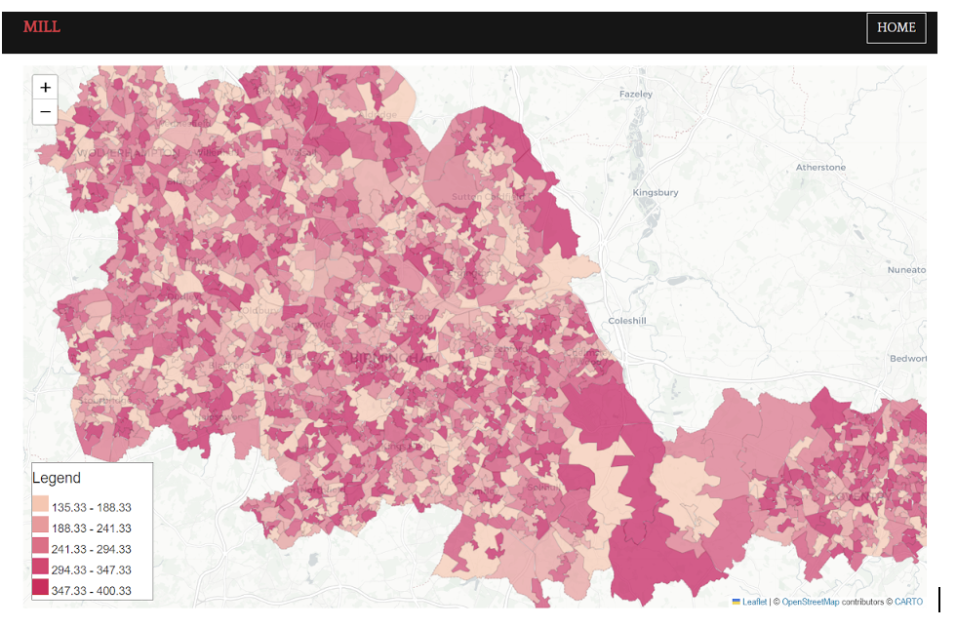
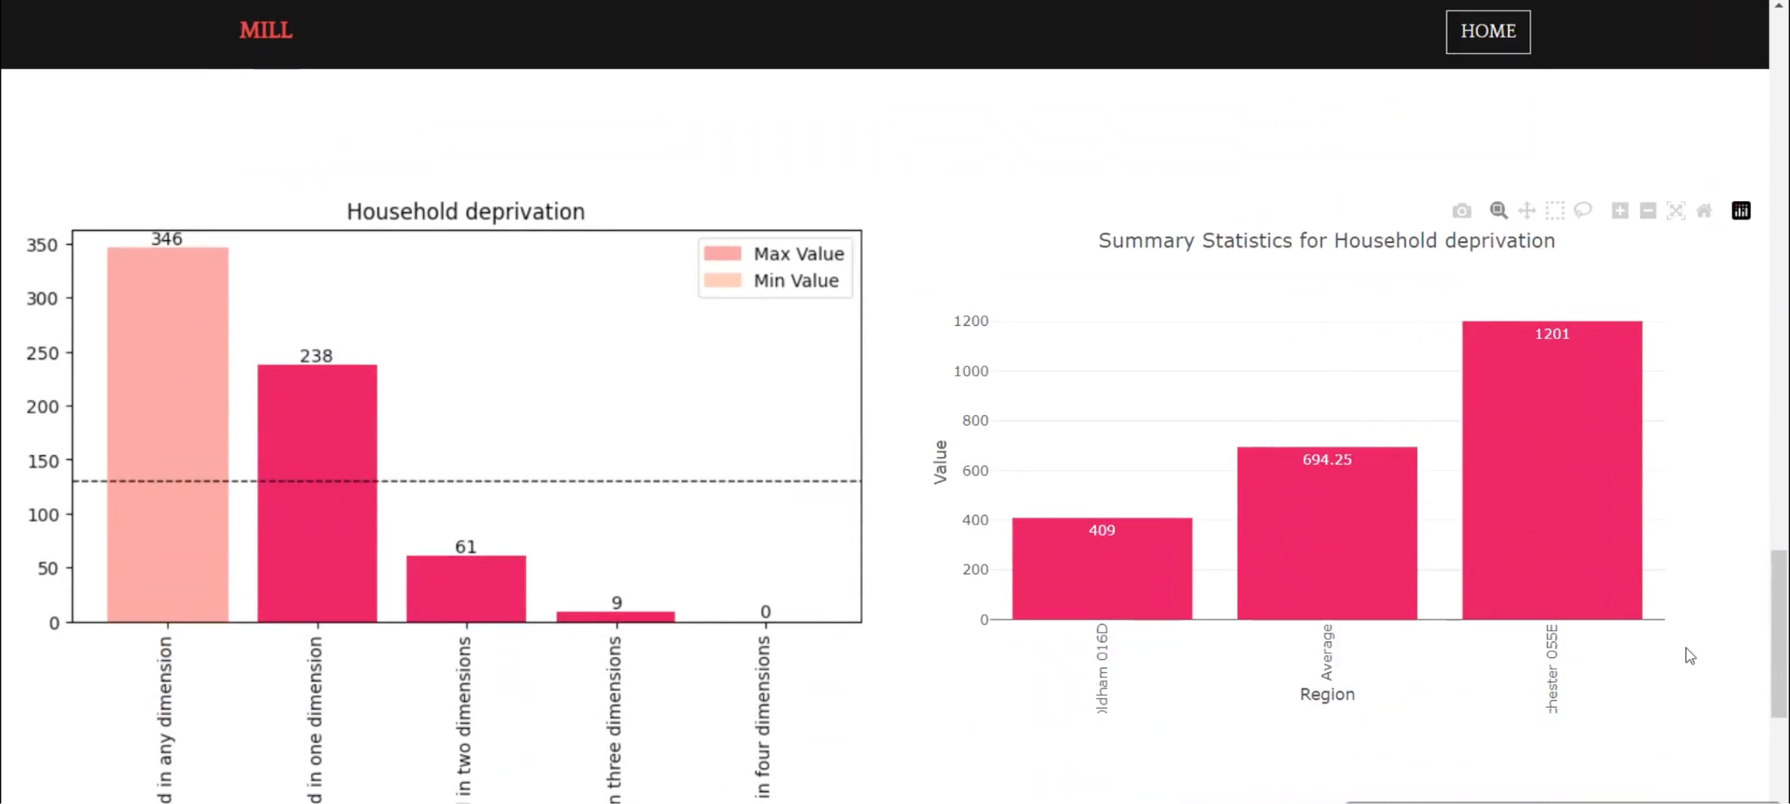
User Interface (UI)
MAP COMPONENTS
The interactive map component is at the core of the application, allowing users to explore and interact with the spatial data.
The "Generate map" button provides the entry point to the mapping functionality, giving users access to the main analytical features.
Map features include:Hover and zoom, enabling exploration of Greater Manchester and West Midlands regions and focusing on specific areas.
Colour scheme used in accordance with “The Mill”.
Option for generating graphs be it a comprehensive overview of the data or for a selected region aids in further analysis.

Slide 15
User Interface (UI)
SCOPE OF IMPROVEMENT
Real-Time Data Input and Collaboration
The team plans to add a feature that will allow users to input data of their choice and access the tool in real-time
This will facilitate collaborative decision-making and knowledge-sharing among users
Exporting Graphs in Different Formats
Users will be provided with options to export graphs in various formats enabling them to share the insights and analysis more easily with others
Expanded Filtering and Geographical Coverage
Additional filtering options will be added to allow for more granular and targeted analysis of the information
The geographical coverage of the analysis will be expanded to include more regions
This will give users more flexibility and control in their data exploration and analysis

Slide 16
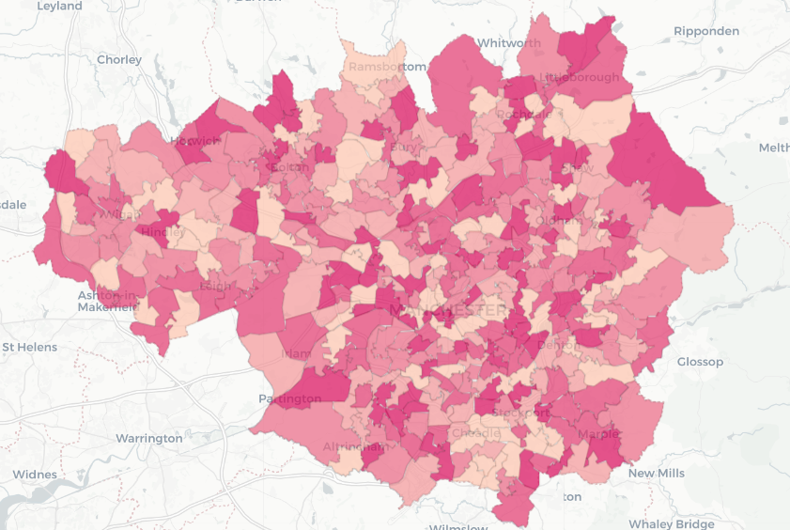
Methodology
1. Identify Map Center
5. Add Interactive Elements
Calculate mean of all the centroids
Configure tooltips and legends
2. Coordinate System transformation
4.Classification and Coloring
Convert all geographic data to the EPSG:4326 coordinate system
Group regions into 5 categories based on the average of all the subcategories
3. Create Map with Folium
Initialize a Folium map and overlay the merged GeoJSON data

Slide 17
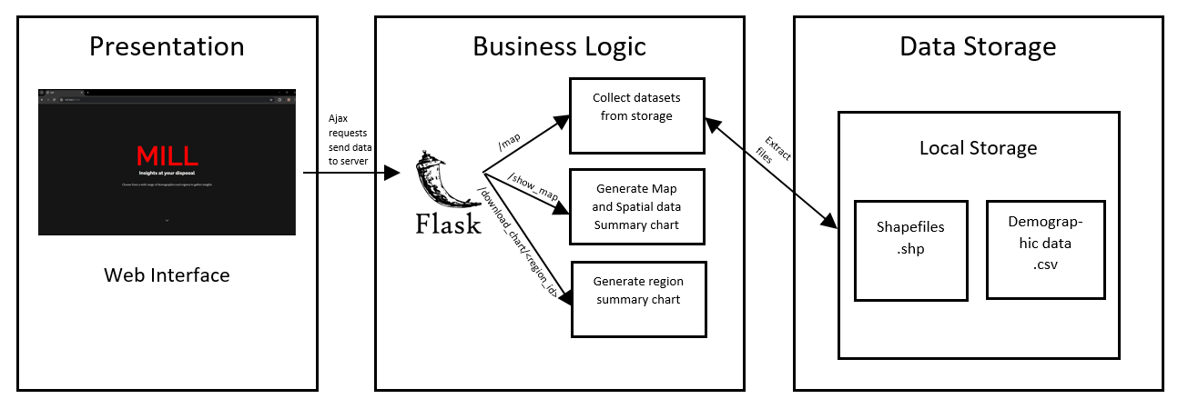
Methodology
Figure 6: System Architecture Diagram
Tools and Technologies:
APIs/ Routes:
Spatial data Collection: ArcGIS
Programming languages: Python(GeoPandas, Folium, Flask) and Javascript(Leaflet.js, OpenLayers)
Data Visualization: Python libraries: Plotly, and Matplotlib.
1. Home Page- /
2. Generate Map- /map
3. Display Map- /show_map
4. Download Chart- /download_chart/<region_id>

Slide 18
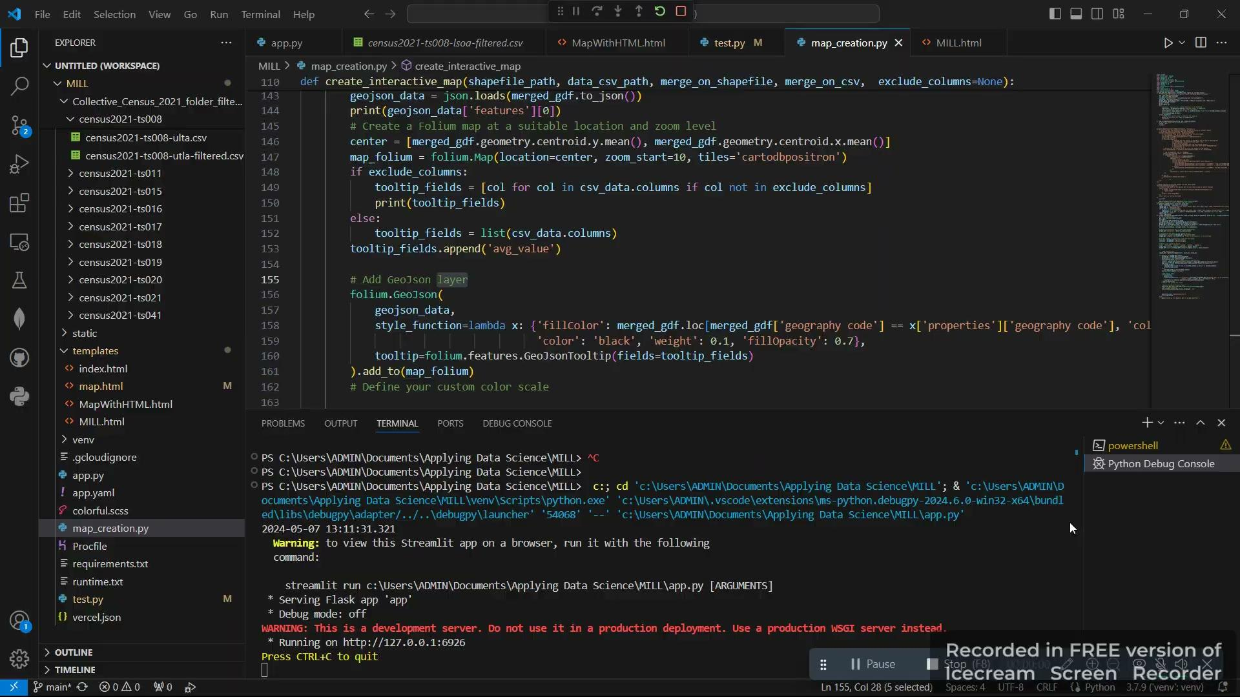
Demo

Slide 19
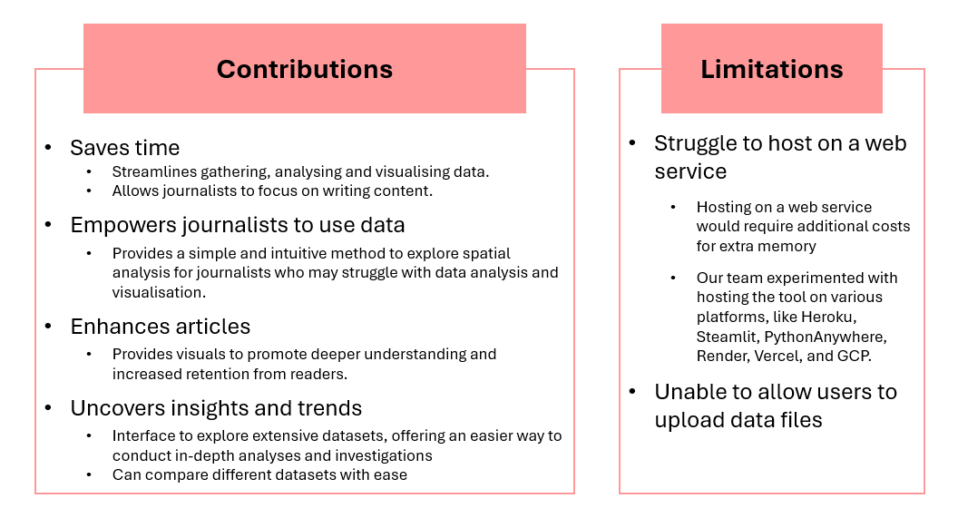
Contributions & Limitations

Slide 20
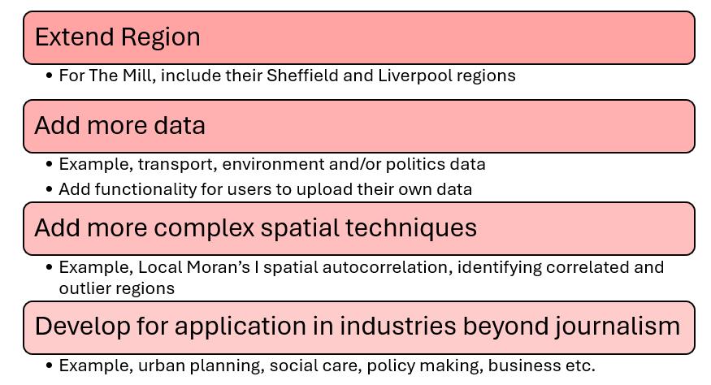
Future Work & Applications

